Slide 1
St George Netball
Rules Information Session
Thursday 6 July 2023

Slide 2
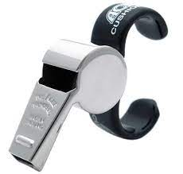
Overview
St George Pathways
Sideline Behaviours
Discipline
Contact and Obstruction
Complaints Process
Questions

Slide 3
1. St George Pathways
Complete online umpire course and umpire exam.
Attend St George Umpire development program.
Receive classification.
Preliminary Level 2 Level 1 National Badge

Slide 4
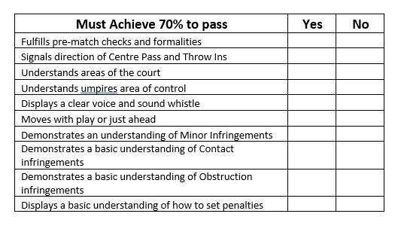
Preliminary
70% pass
Training Vest
Club Support person
Obstruction and contact (basic)

Slide 5
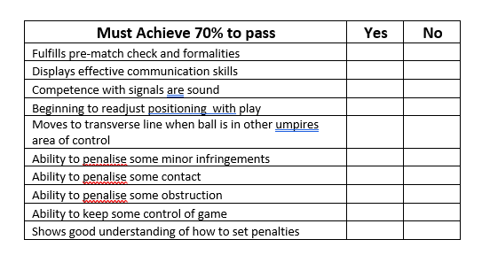
Level 2
Greater control
Some minor infringements
Some contact/obstruction

Slide 6
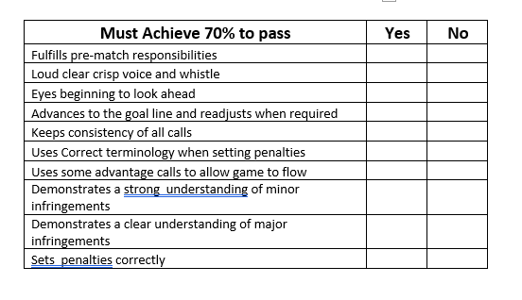
Level 1
Looking ahead
Correct terminology
Some advantage
Strong, clear understanding of infringements

Slide 7
Allocation Process
Each grade has been aligned with a minimum umpire standard
Club umpire is registered with
Ladder
Umpires Committee
Tracie Davies – umpire convenor
Maria Ao
Marcus Puroku
Jessica Dean
Lylia Franich

Slide 8
2. Sideline Behaviours
No spectator, coach, parent is to approach an umpire in any circumstance
Captain may approach during a break to clarify a rule -rule book

Slide 9
3. Discipline
The umpires apply the Rules of the Game fairly, communicate clearly and maintain a calm, decisive control. A player who infringes any part of the foul play rule [Rule 13.2] will be disciplined. Players on the court are expected to respond to rulings by the umpires and adjust their play accordingly. Similar requirements apply to team officials and bench players.

Slide 10
4. Contact and Obstruction
11.1 OBSTRUCTION OF A PLAYER IN POSSESSION OF THE BALL An opposing player may attempt to deflect or intercept the ball or defend a player in possession of the ball, provided there is a distance of not less than 0.9 m (3 ft) measured on the ground from the nearest part of the landing foot of the player with the ball to the nearest part of the opposing player’s nearer foot.
3ft arc around player (distance of centre circle)
Player steps in
Umpires interpretation/consistency
Player cannot run with arms extended out across player

Slide 11
12.1 CONTACT AND CONTEST When attacking, defending or playing the ball, opposing players may come into physical contact with each other. Provided the players do not interfere with each other’s play or use their bodies to gain an unfair advantage over their opponent, it is deemed to be ‘contest’ and play continues. ‘Contact’ occurs when a player’s actions interfere with an opponent’s play whether these are accidental or deliberate.
contact verse contest
simultaneous contact

Slide 12
5. Complaints Process
If you have any concerns regarding an umpire please see your club executive or come up to control DURING the game to speak to a member of the umpires committee.
You are not to approach an umpire at any point during or after the game.
Written reports are to be submitted to St George exec, by your club within 48 hours.
Any incidents of umpire dissent will receive an automatic 1 week ban.

Slide 13
6. Questions

